Slide 1

Computer Networks
王廷
华东师范大学 软件工程学院
Email: twang@sei.ecnu.edu.cn
Office: 理科大楼B1116室

Slide 2
Chapter 5：Network Layer
  Design Issues
  Routing Algorithms
  Congestion Control
  Quality of Service
  Internetworking
  Network Layer of the Internet

Slide 3
The Network Layer
Builds on the link layer. Routers send packets over multiple networks.
Responsible for delivering packets between endpoints over multiple links
Application
Transport
Network
Link
Physical

Slide 4
Network layer design issues: Introduction
Data link layer v.s. network layer
  Data link layer: to move frames from one end of a wire to the other.
  Network layer: to move packets from the source all the way to the destination. It deals with end-to-end transmissions.
Network layer
  Must know about the topology of the communication subnet and choose appropriate paths through it.
  Must choose routes to avoid overloading some of the communication lines and routers while leaving others idle.
  To deal with internetwork different networks.

Slide 5
Design Issues
  Store-and-forward packet switching »
  Connectionless service – datagrams »
  Connection-oriented service – virtual circuits »
  Comparison of virtual-circuits and datagrams »

Slide 6
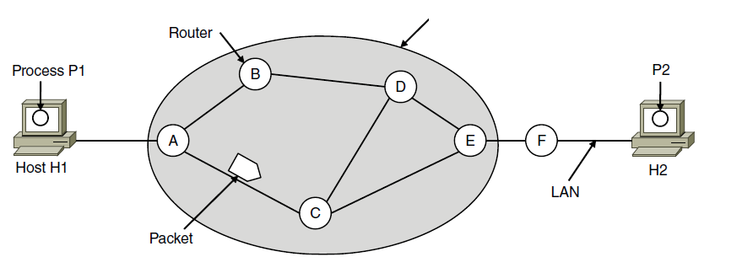
Store-and-Forward Packet Switching
A host with a packet to send transmits it to the nearest router. The packet is received, verified, and stored. Then it is forwarded to the next router. This step can be repeated many times. Finally the packet reaches the destination host.
Hosts send packets into the network; packets are forwarded by routers
ISP’s equipment
Packetizing：encapsulating the payload in a network-layer packet at the source and decapsulating the payload from the network-layer packet at the destination.
Routing and forwarding

Slide 7


Services provided to the transport layer
Two-type of services:
  Connection-less services: (➔Datagram)
    30 years of experience with the computer network, unreliable internet, hosts doing error control and flow control
  Connection-oriented services. (➔Virtual Circuit)
    100 years of experience with the worldwide telephone system, quality of service

Slide 8
Connectionless & connection-oriented service
Connectionless service
  each packet is treated independently
  the network layer is only responsible for delivery of packets from the source to the destination
  the packets in a message may or may not travel the same path to their destination.
Connection-oriented service
  Before all datagrams in a message can be sent, a virtual connection should be set up to define the path for the datagrams.
  After connection setup, the datagrams can all follow the same path.
  The packet contain the source and destination addresses, also a flow label, a virtual circuit identifier that defines the virtual path the packet should follow.

Slide 9
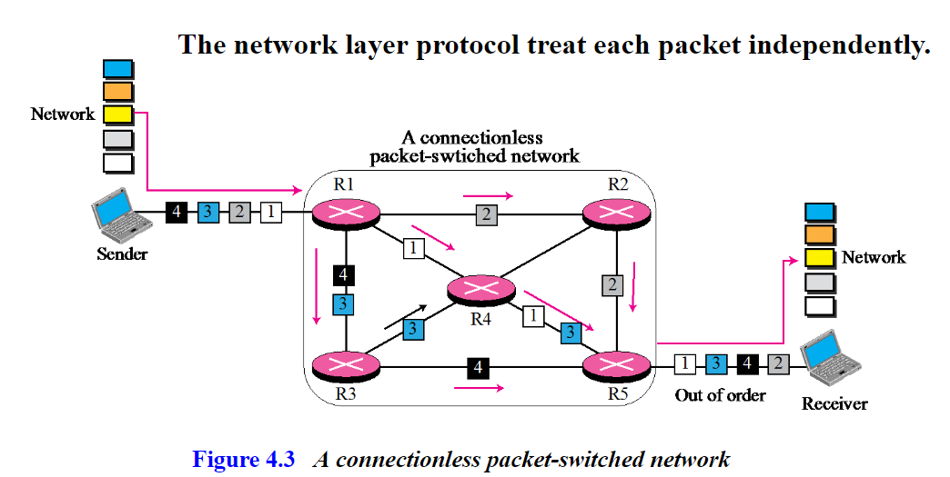
Connectionless service

Slide 10
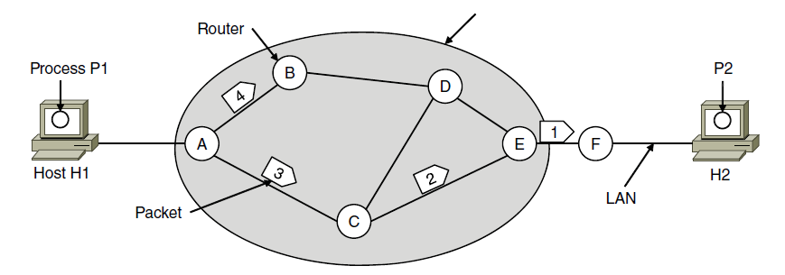
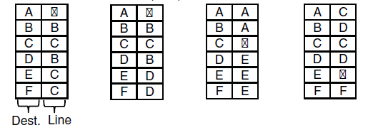
Connectionless Service – Datagrams
Packet is forwarded using destination address inside it
  Different packets may take different paths
ISP’s equipment
A’s table (initially) A’s table (later) C’s Table E’s Table
B
B
Dest. Line

Slide 11
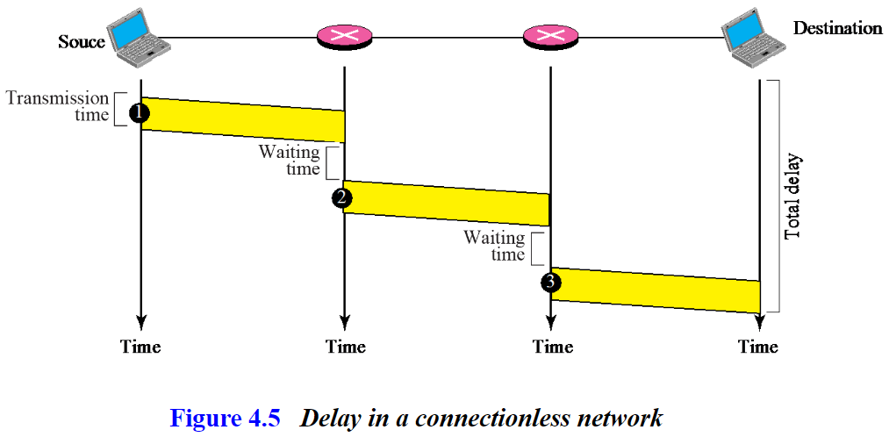
Delay in a connectionless network
Processing time+ transmission time+ queuing time
Propagation time
Notes:
This model is like the postal service – each letter is sent through the network independently.
Datagram is a packet that contains an absolute destination address; routers need only look up the destination address in a table to find the outgoing line to send the packet on its way.

Slide 12
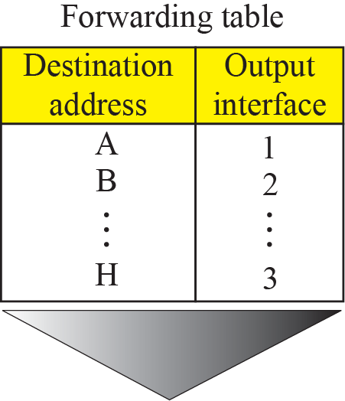
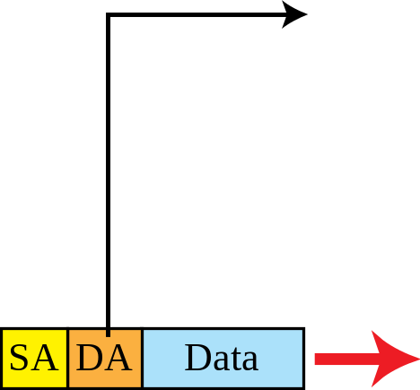
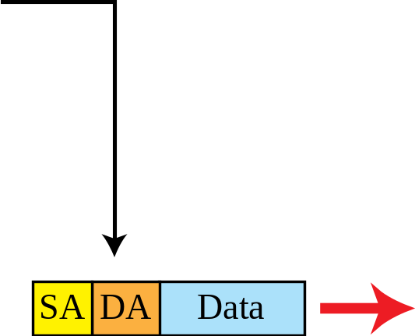
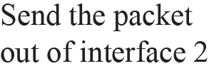
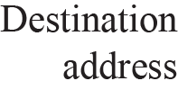
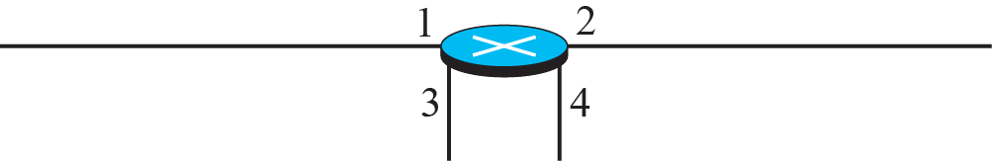
Forwarding process in a router when used in a connectionless network

Slide 13
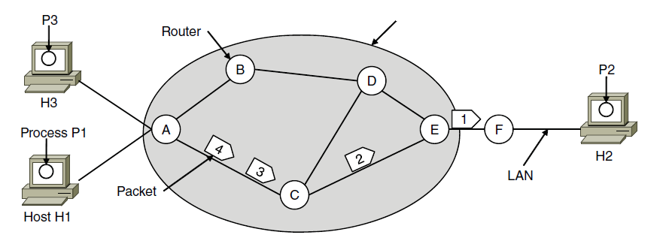

Connection-Oriented – Virtual Circuits
Packet is forwarded along a virtual circuit using tag inside it
  Virtual circuit (VC) is set up ahead of time
  Every router on source-dest path maintains “state” for each passing connection
  Link, router resources (bandwidth, buffers) may be allocated to VC (dedicated resources = predictable service)
ISP’s equipment
A’s table C’s Table E’s Table
In: Line Tag
Line Tag: Out
Notes:
As an example, consider the situation shown in Fig. 5-3. Here, host H1 has established connection 1 with host H2. This connection is remembered as the first entry in each of the routing tables. The first line of A’s table says that if a packet bearing connection identifier 1 comes in from H1, it is to be sent to router C and given connection identifier 1. Similarly, the first entry at C routes the packet to E, also with connection identifier 1. Now let us consider what happens if H3 also wants to establish a connection to H2. It chooses connection identifier 1 (because H3 is initiating the connection and this is its only connection) and tells the network to establish the virtual circuit. This leads to the second row in the tables. Note that we have a conflict here be-cause although A can easily distinguish connection 1 packets from H1 from connection 1 packets from H3, C cannot do this. For this reason, A assigns a different connection identifier to the outgoing traffic for the second connection. Avoiding conflicts of this kind is why routers need the ability to replace connection identifiers in outgoing packets. In some contexts, this process is called label switching. An example of a connection-oriented network service is MPLS (Multi-Protocol Label Switching).

Slide 14
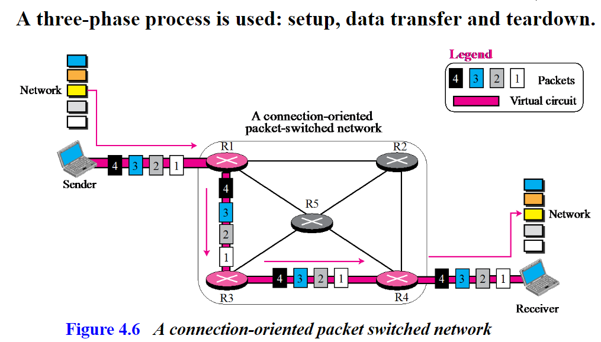
Connection-Oriented Service – Packet Switching
Notes:
This model is like the telephone network.
Packets contain tags that are not full addresses; they only need to be unique at a given link and thus are re-written at each router from an incoming tag to an outgoing tag. The virtual circuit is set up with the tag mapping along the entire path. Then packets are sent along it. The packets will thus all follow the same path (and arrive in order).
“Virtual” refers to the fact that real/physical telephone circuits have both a path and a fixed bandwidth reservation of 64Kbps, whereas virtual circuits may have a variable bandwidth depending on how many VCs use a single link.
As an example, consider the situation shown in Fig. 5-3. Here, host H1 has established connection 1 with host H2. This connection is remembered as the first entry in each of the routing tables. The first line of A’s table says that if a packet bearing connection identifier 1 comes in from H1, it is to be sent to router C and given connection identifier 1. Similarly, the first entry at C routes the packet to E, also with connection identifier 1. Now let us consider what happens if H3 also wants to establish a connection to H2. It chooses connection identifier 1 (because H3 is initiating the connection and this is its only connection) and tells the network to establish the virtual circuit. This leads to the second row in the tables. Note that we have a conflict here be-cause although A can easily distinguish connection 1 packets from H1 from connection 1 packets from H3, C cannot do this. For this reason, A assigns a different connection identifier to the outgoing traffic for the second connection. Avoiding conflicts of this kind is why routers need the ability to replace connection identifiers in outgoing packets. In some contexts, this process is called label switching. An example of a connection-oriented network service is MPLS (Multi-Protocol Label Switching).

Slide 15
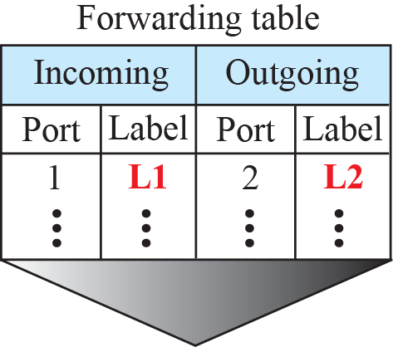
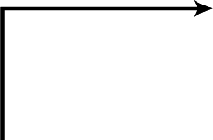
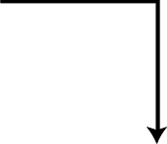


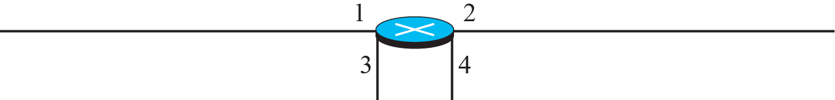


Forwarding process in a router when used in a virtual circuit network

Slide 16
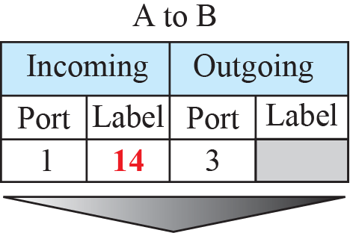
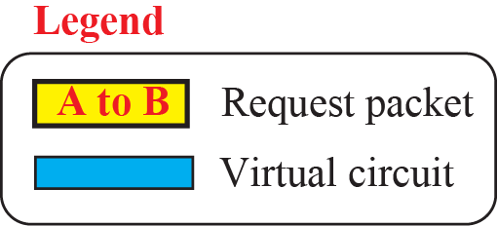
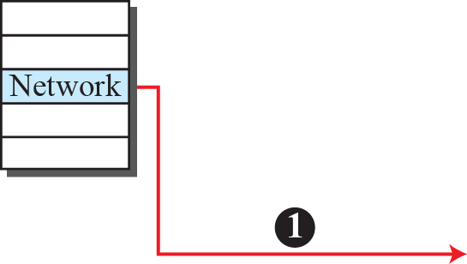
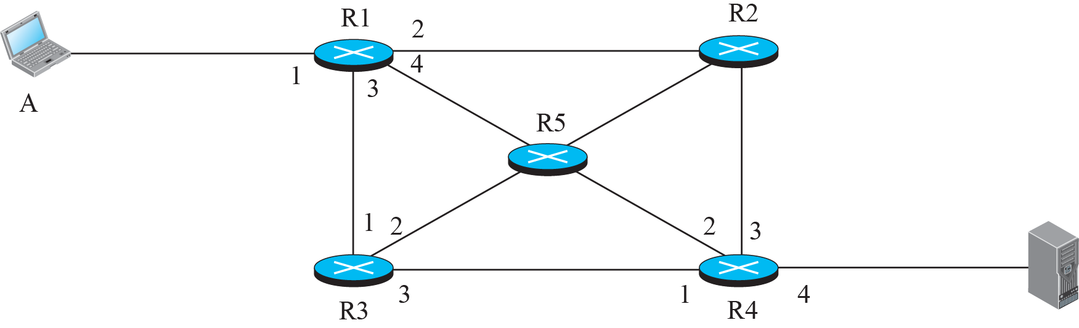

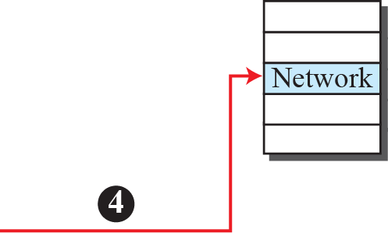


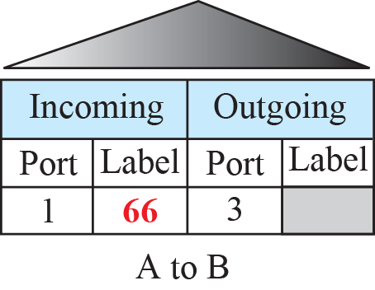
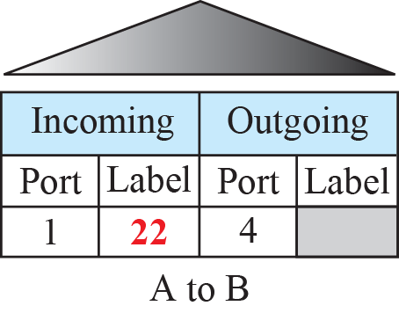
Sending request packet in a virtual-circuit network

Slide 17
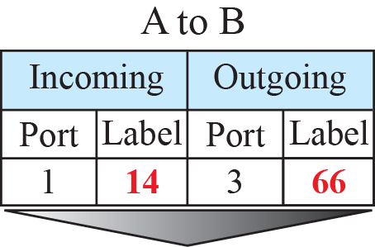
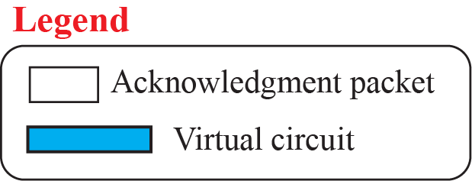
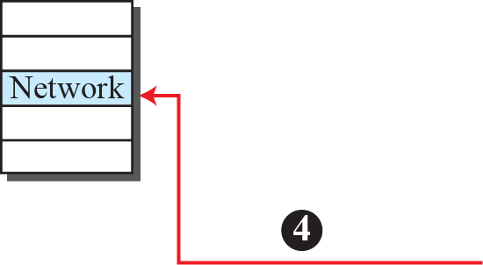

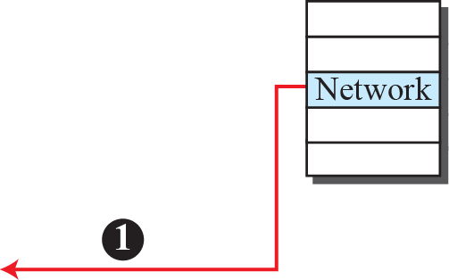





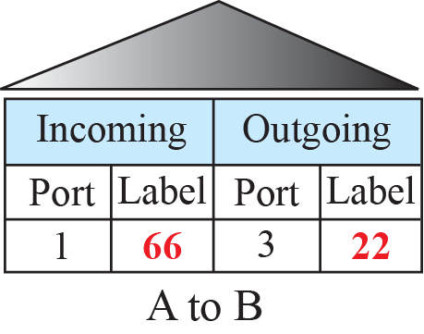
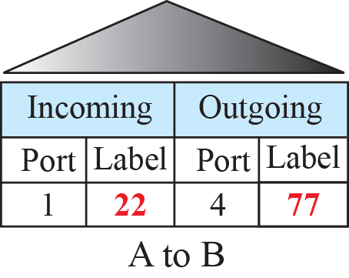
Sending acknowledgments in a virtual-circuit network
The incoming label of the packet’s header is used as the outgoing label of next router.

Slide 18
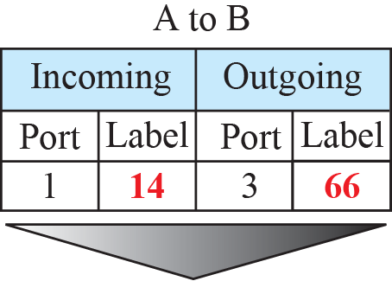
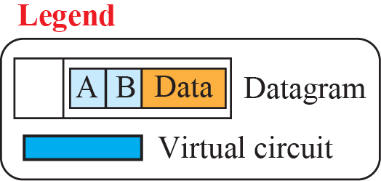
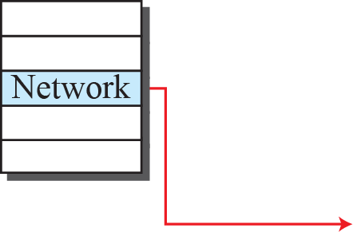

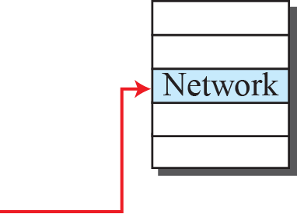



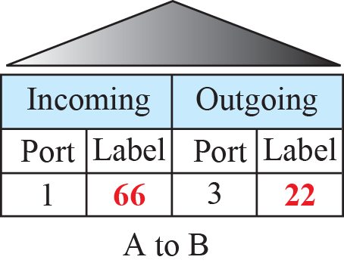
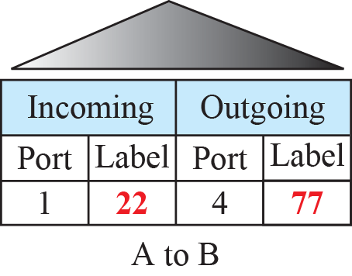
Flow of one packet in an established virtual circuit

Slide 19
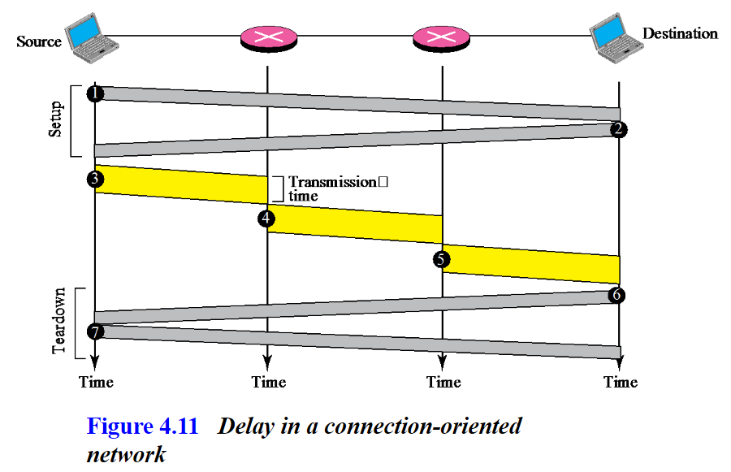
Delay in a connection-oriented network
Notes:
This model is like the postal service – each letter is sent through the network independently.
Datagram is a packet that contains an absolute destination address; routers need only look up the destination address in a table to find the outgoing line to send the packet on its way.

Slide 20
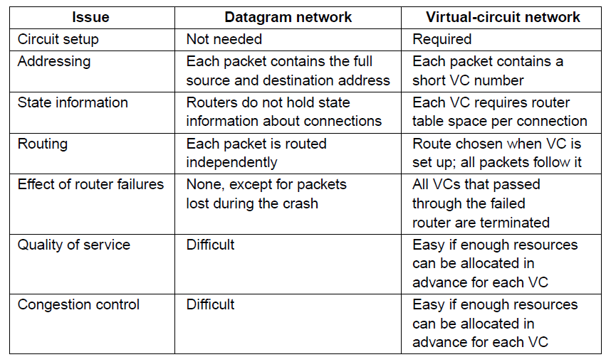
Comparison of Virtual-Circuits & Datagrams

Slide 21
Chapter 5：Network Layer
  Design Issues
  Routing Algorithms
  Congestion Control
  Quality of Service
  Internetworking
  Network Layer of the Internet

Slide 22
Routing Algorithms (1)
  Optimality principle »
  Shortest path algorithm »
  Flooding »
  Distance vector routing »
  Link state routing »
  Hierarchical routing »
  Broadcast routing »
  Multicast routing »
  Anycast routing »
  Routing for mobile hosts »
  Routing in ad hoc networks »

Slide 23
Routing Algorithms (2)
In unicast routing, a packet is routed, hop by hop, from its source to its destination by the help of forwarding tables.
The source host needs no forwarding table because it delivers its packet to the default router in its local network.
The destination host needs no forwarding table either because it receives the packet from its default router in its local network.
Only the routers that glue together the networks in the internet need forwarding tables.

Slide 24
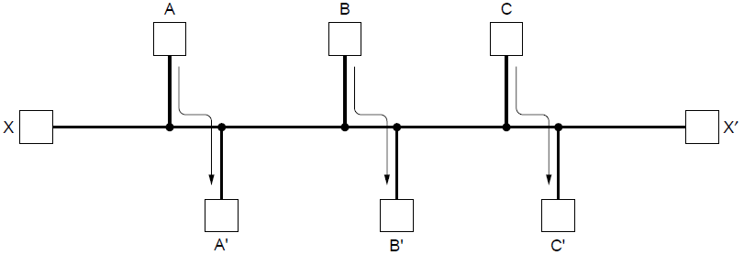
Routing Algorithms (3)
Routing is the process of discovering network paths
  Model the network as a graph of nodes and links
  Decide what to optimize (e.g., fairness vs efficiency)
  Update routes for changes in topology (e.g., failures)
Forwarding is the sending of packets along a path
  Handles each packet as it arrives
  Looking up the outgoing line to use for it in the routing tables.
The traffic demands A->A’, B->B’, C->C’ and X->X’.
What would be fair?
What would be efficient?
Notes:
For the graph, the traffic demands are A->A’, B->B’, C->C’ and X->X’. What would be fair? For each flow they get the same amount of bandwidth. If all network links have unit capacity then we would give each flow ½ a unit of capacity. The total network traffic is then 2 units. What would be efficient? If we gave the X->X’ flow no bandwidth then we could give each of the other three flows 1 unit. The total network traffic is then 3 units. So it is more efficient, but it is not fair. So we will have to decide what we want to optimize.

Slide 25
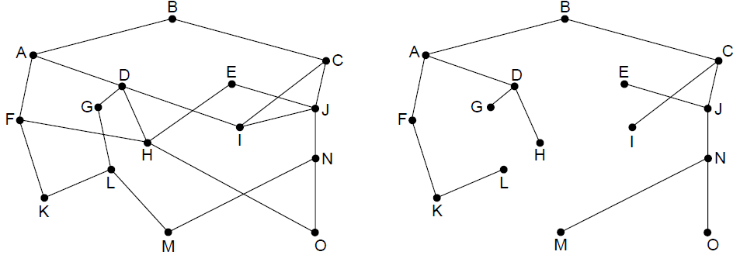
The Optimality Principle
Each portion of a best path is also a best path; the union of them to a router is a tree called the sink tree
  Best means fewest hops in the example
B
最佳路径可能不唯一
H-D-A-B, or H-F-A-D
随机选择一个
Multi-path routing
Network
Sink tree of best paths to router B
Notes:
Proof by contradiction: if a portion of a best path is not a best path then there is something better. Substitute this better portion and you would have a better overall path, which cannot be the case if the overall path is a best path.
For sink trees, if there are multiple paths that are equally good, then one best path from one node to another is chosen at random. For example, H can be reached in 3 hops via H-D-A-B as shown, or by H-F-A-D (not shown). This is simple and useful as there is a single route from each router to each destination. If, instead, all equally best paths are kept then their union is a DAG (directed acyclic graph). This is a more general case that permits multiple paths from a router to a destination.

Slide 26
Shortest Path Algorithm (1)
Dijkstra’s algorithm computes a sink tree on the graph:
  Each link is assigned a non-negative weight/distance
  Shortest path is the one with lowest total weight
  Using weights of 1 gives paths with fewest hops
Algorithm:
  Start with sink, set distance at other nodes to infinity
  Relax distance to other nodes
  Pick the lowest distance node, add it to sink tree
  Repeat until all nodes are in the sink tree
Notes:
The notion of weight generalizes distance to other cost metrics. Setting weights to be 1 gives paths with fewest hops. Setting weight to be distance gives paths that are shortest or lowest delay. Setting weight to be lower for higher capacity links favors higher capacity paths.

Slide 27
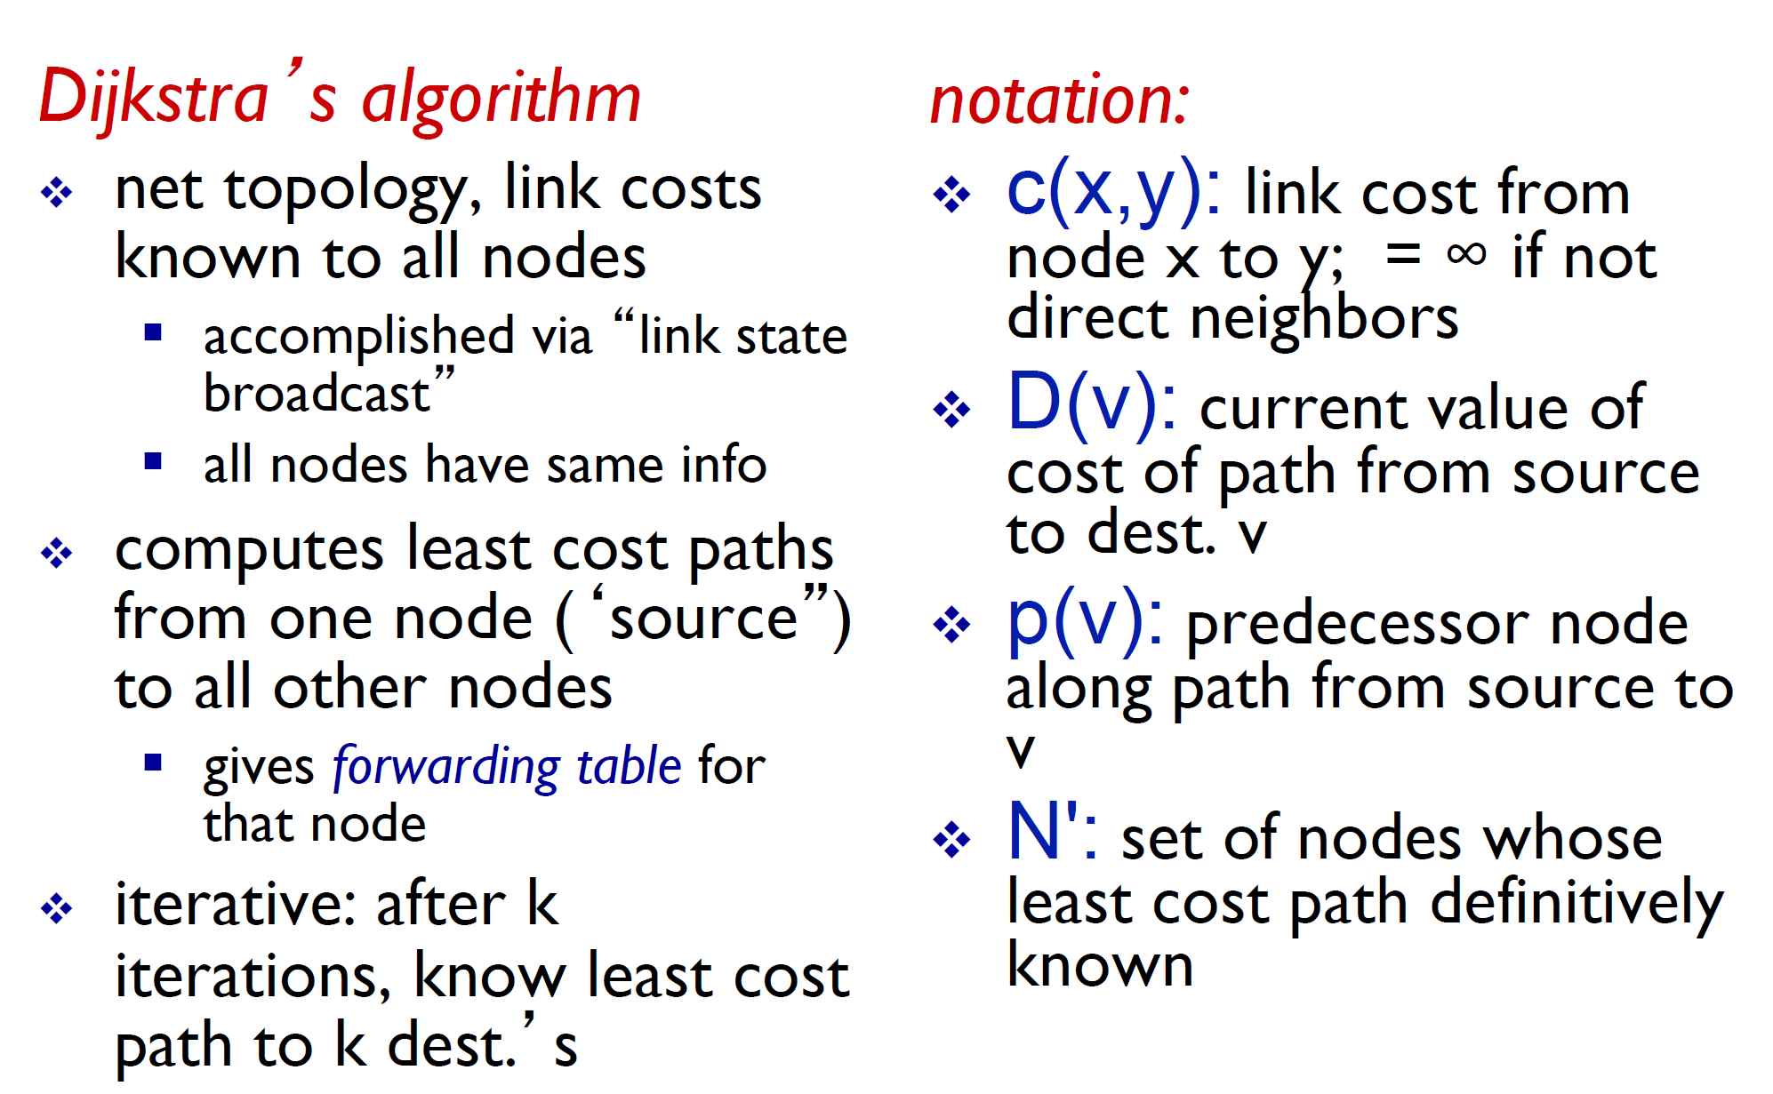
Dijkstra’s algorithm

Slide 28
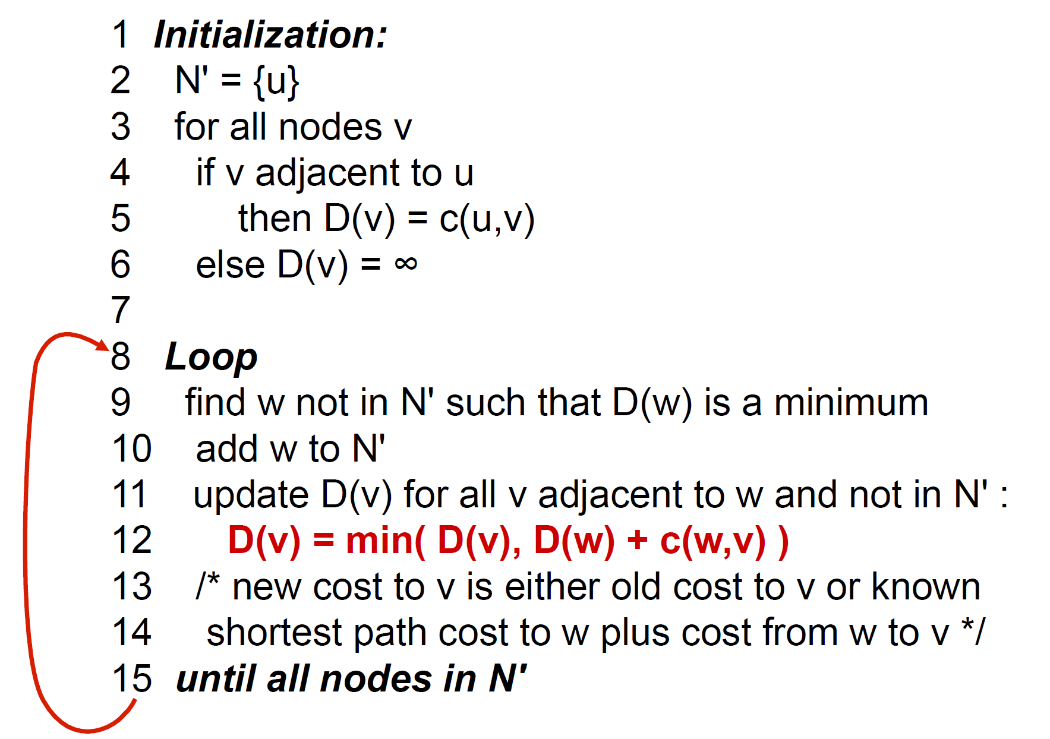
Dijkstra’s algorithm

Slide 29
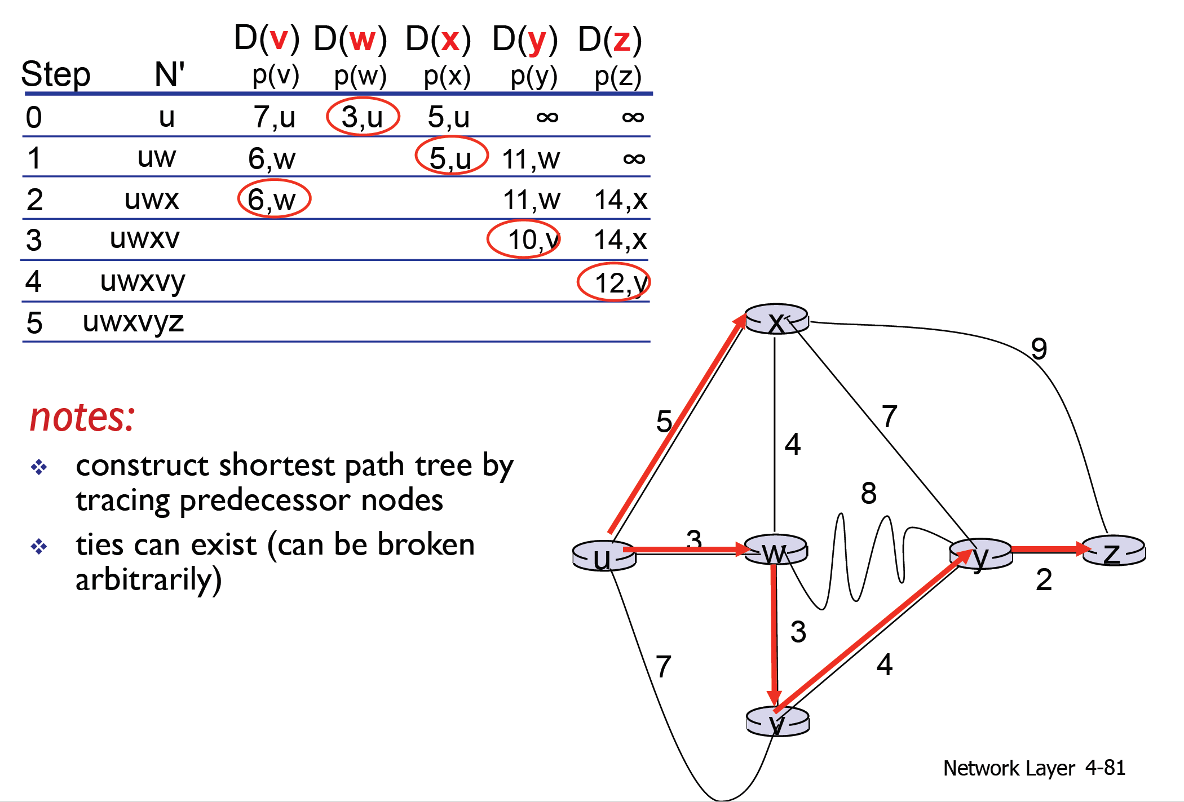
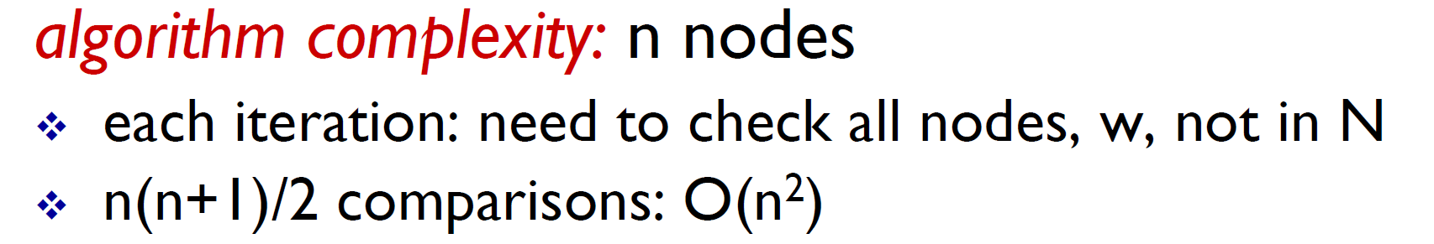
Dijkstra’s algorithm: example

Slide 30
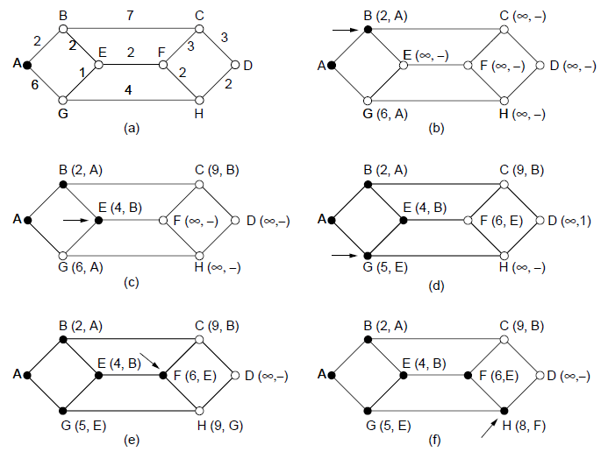
Shortest Path Algorithm (2)
A network and first five steps in computing the shortest paths from A to D. Pink arrows show the sink tree so far.

Slide 31
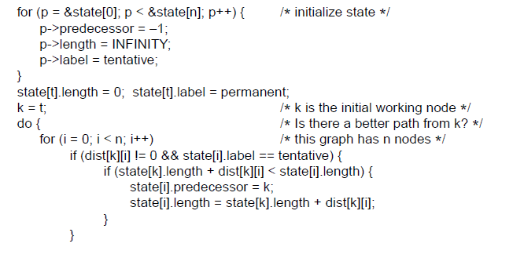
Shortest Path Algorithm (3)
. . .
Start with the sink, all other nodes are unreachable
Relaxation step. Lower distance to nodes linked to newest member of the sink tree
. . .

Slide 32
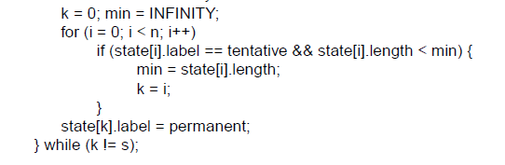
Shortest Path Algorithm (4)
. . .
Find the lowest distance, add it to the sink tree, and repeat until done
Notes:
This code keeps going until it reaches a sought-after destination node; if it continued until there were no tentative nodes then it would have found the entire sink tree.
The predecessor links can be reversed to find the path from t -> s instead of from s -> t. This is because the link has the same cost in each direction so paths are symmetrical (or the same in each direction).

Slide 33
Flooding(1)
A simple method to send a packet to all network nodes
Each node floods a new packet received on an incoming link by sending it out all of the other links
Nodes need to keep track of flooded packets to stop the flood; even using a hop limit can blow up exponentially
Throw out duplicate packets
  Hop counter
  To keep track of the flooded packets
Notes:
Note that flooding doesn’t actually find any routes that can be reused.

Slide 34
Flooding(2)
Flooding is not practical:
  Sending most packets
  Wasteful
Flooding is Useful:
  Ensures that a packet is delivered to every node.
  Effective for broadcasting information.
  Tremendously robust and localized.
  Will find a path if one exists.
  Routers only need to know their neighbors.

Slide 35
Routing Types
默认路由 Default Routing
静态路由 Static Routing
动态路由 Dynamic Routing
  距离矢量路由协议
  链路状态路由协议

Slide 36
Distance Vector Routing
Distance vector is a distributed routing algorithm
  Shortest path computation is split across nodes
  The distance vector routing algorithm: Bellman-Ford Algorithm
Algorithm:
  Each node knows distance of links to its neighbors
  Each node advertises vector of lowest known distances to all neighbors
  Each node uses received vectors to update its own
  Repeat periodically

Slide 37
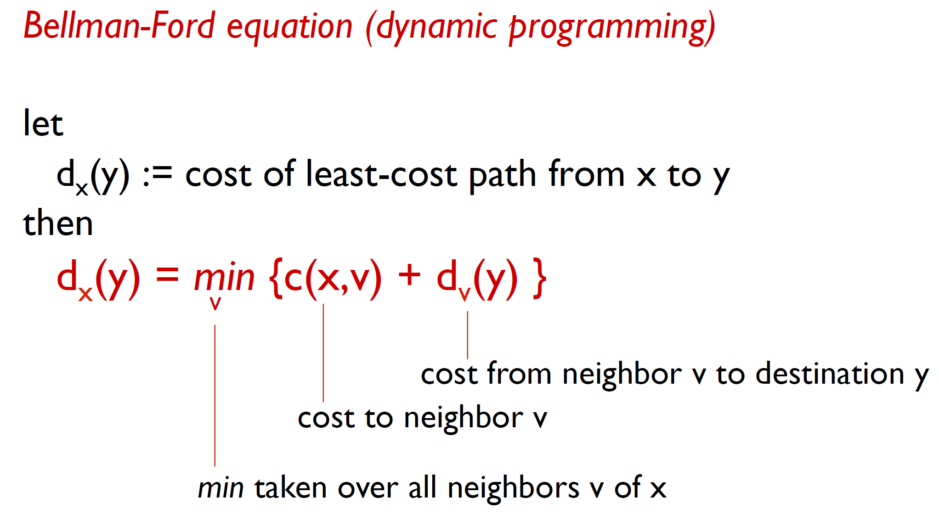
Distance Vector Routing

Slide 38
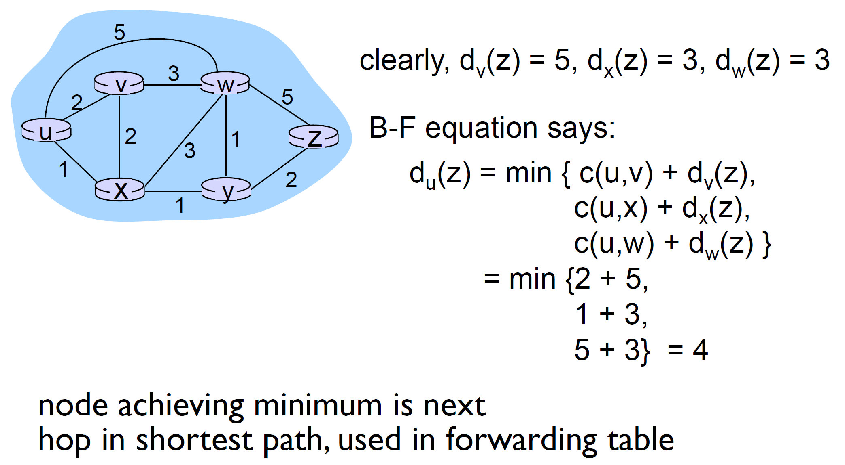
Bellman-Ford Example

Slide 39
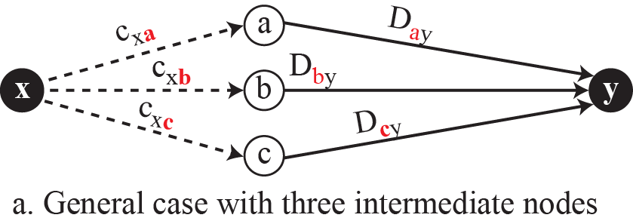

Graphical idea behind Bellman-Ford equation

Slide 40


The distance vector corresponding to a tree

Slide 41








The first distance vector for an internet

Slide 42



Updating distance vectors

Slide 43

Distance Vector Routing – An Example
Consider how J computes its new route to router G. It knows that it can get to A in 8 msec, and furthermore A claims to be able to get to G in 18 msec, so J knows it can count on a delay of 26 msec to G if it forwards packets bound for G to A. Similarly, it computes the delay to G via I, H, and K as 41 (31 + 10), 18 (6 + 12), and 37 (31 + 6) msec, respectively. The best of these values is 18, so it makes an entry in its routing table that the delay to G is 18 msec and that the route to use is via H. The same calculation is performed for all the other destinations, with the new routing table shown in the last column of the figure.
8
12
10
6
Network
New vector for J
Vectors received at J from
Neighbors A, I, H and K

Slide 44

The Count-to-Infinity Problem
Failures can cause DV to “count to infinity” while seeking a path to an unreachable node
X
Good news of a path to A spreads quickly
Bad news of no path to A is learned slowly
Notes:
To see how fast good news propagates, consider the five-node (linear) net-work of Fig. 5-10, where the delay metric is the number of hops. Suppose A is down initially and all the other routers know this. In other words, they have all recorded the delay to A as infinity.
When A comes up, the other routers learn about it via the vector exchanges. At the time of the first exchange, B learns that its left-hand neighbor has zero delay to A. B now makes an entry in its routing table indicating that A is one hop away to the left. All the other routers still think that A is down. At this point, the routing table entries for A are as shown in the second row of Fig. 5-10(a). On the next exchange, C learns that B has a path of length 1 to A, so it updates its routing table to indicate a path of length 2, but D and E do not hear the good news until later. Clearly, the good news is spreading at the rate of one hop per exchange. In a network whose longest path is of length N hops, within N exchanges everyone will know about newly revived links and routers.
Now let us consider the situation of Fig. 5-10(b), in which all the links and routers are initially up. Routers B, C, D, and E have distances to A of 1, 2, 3, and 4 hops, respectively. Suddenly, either A goes down or the link between A and B is cut (which is effectively the same thing from B’s point of view).
At the first packet exchange, B does not hear anything from A. Fortunately, C says ‘‘Do not worry; I have a path to A of length 2.’’ Little does B suspect that C’s path runs through B itself. For all B knows, C might have ten links all with separate paths to A of length 2. As a result, B thinks it can reach A via C, with a path length of 3. D and E do not update their entries for A on the first exchange.
On the second exchange, C notices that each of its neighbors claims to have a path to A of length 3. It picks one of them at random and makes its new distance to A 4, as shown in the third row of Fig. 5-10(b). Subsequent exchanges produce the history shown in the rest of Fig. 5-10(b).
From this figure, it should be clear why bad news travels slowly: no router ever has a value more than one higher than the minimum of all its neighbors. Gradually, all routers work their way up to infinity, but the number of exchanges required depends on the numerical value used for infinity. For this reason, it is wise to set infinity to the longest path plus 1.
Not entirely surprisingly, this problem is known as the count-to-infinity prob-lem. There have been many attempts to solve it, for example, preventing routers from advertising their best paths back to the neighbors from which they heard them with the split horizon with poisoned reverse rule discussed in RFC 1058. However, none of these heuristics work well in practice despite the colorful names. The core of the problem is that when X tells Y that it has a path some-where, Y has no way of knowing whether it itself is on the path.

Slide 45

Example 1
考虑如下子网，A、B、C、D为路由器。采用距离矢量路由算法。
（1）分析A路由器的路由表中存储的A到路由器B的距离及形成过程。
（2）假设链路BD断开，分析A路由器的路由表中存储的A到路由器B的距离的变化过程。
（3）在链路BD断开一段时间后，进一步假设链路AB也断开，分析A路由器在构造路由表，生成A到路由器B的距离时会出现什么问题？
答：
（1）A初始时记录到B的距离为11。当A收到D发来的申明：“到B的距离为3”，A修改自己的路由表项：“到B的距离为10，通过D”；同时C申明：“到B的距离为4，通过D”，故A修改其路由表：“到A的距离为6，通过C”。
（2）所有路由器重新查找到B的路径。所有路由器通过A到B。路由器A到B的距离为11。
（3）会出现“无穷计算问题”。

Slide 46

Example 2
对于下图所示的通信子网，采用距离矢量路由选择算法。当以下矢量刚进入路由器C：
来自B：(5，0，8，12，6，2)表示B到A、B、C、D、E、F的延迟分别为5，0，8，12，6，2
来自D：(16，12，6，0，9，10)表示D到A、B、C、D、E、F的延迟分别为16，12，6，0，9，10
来自E：(7，6，3，9，0，4)表示E到A、B、C、D、E、F的延迟分别为7，6，3，9，0，4
C到B、D、E的延迟分别为6，3，5。请问C的路由表是什么？即给出采用的输出线路和预计延迟。
6
答：
5
3
目的地 | 预计延迟 | 输出线路
A | 11 | B
B | 6 | B
C | 0 | -
D | 3 | D
E | 5 | E
F | 8 | B

Slide 47
Link State Routing (1)
Link state is an alternative to distance vector
  More computation but simpler dynamics
  Widely used in the Internet (OSPF, ISIS)
Algorithm:
  Discover its neighbors, learn their network address.
  Measure the delay or cost to each of its neighbors.
  Construct a packet (Link State Packet) about its neighbors.
  Each node floods information about its neighbors in LSPs (Link State Packets); all nodes learn the full network graph
  Each node runs Dijkstra’s algorithm to compute the path to take for each destination

Slide 48

Learning about the Neighbors
(a) Nine routers and a LAN. (b) A graph model of (a).

Slide 49

Measuring Line Cost
A subnet in which the East and West parts are connected by two lines.

Slide 50

Link State Routing (2) – Building Links State Packets (LSPs)
LSP (Link State Packet) for a node lists neighbors and weights of links to reach them
Network
LSP for each node

Slide 51


Distributing LSPs – Reliable Flooding
Seq. number and age are used for reliable flooding
  New LSPs are acknowledged on the lines they are received and sent on all other lines
  Example shows the LSP database at router B
The send flags mean that the packet must be sent on the indicated link. The ack flags mean that it must be acknowledged there.
The LSP from A arrives directly, so it must be sent to C and F and ACKed to A, as indicated by the flag bits. Similarly, the packet from F has to be forwarded to A and C and ACKed to F.
However, packet from E, is different. It arrives twice, once via EAB and once via EFB. Consequently, it has to be sent only to C but must be ACKed to both A and F, as indicated by the bits.
The data structure used by router B for the network in the previous slide.
Age filed: decrement it once per second. When the age hits zero, the information from that router is discarded.

Slide 52


Slide 53


Slide 54


Slide 55


Slide 56


Slide 57



Slide 58



Slide 59


Slide 60



Slide 61

Hierarchical Routing
Hierarchical routing reduces the work of route computation but may result in slightly longer paths than flat routing
The advantages are：
smaller routing tables,
smaller routing computations to run at nodes,
and fewer/smaller messages to send to describe the network.
Best choice to reach nodes in 5 except for 5C

Slide 62

Broadcast Routing
Broadcast sends a packet to all nodes
  RPF (Reverse Path Forwarding): send broadcast received on the link to the source out all remaining links
  Alternatively, can build and use sink trees at all nodes
Network
Sink tree for I is efficient broadcast
The tree built by RPF

Slide 63

Multicast Routing
组播（multicast）是在一台源IP主机和多台（一组）IP主机之间进行，中间的交换机和路由器根据接收者的需要，有选择性地对数据进行复制和转发。

Slide 64

Multicast Routing

Slide 65

Multicast Routing (1) – Dense Case
Multicast sends to a subset of the nodes called a group
  Uses a different tree for each group and source
S
S
Network with groups 1 & 2
Spanning tree from source S
S
S
Multicast tree from S to group 1
Multicast tree from S to group 2

Slide 66

Multicast Routing (2) – Sparse Case
CBT (Core-Based Tree) uses a single tree to multicast
  Tree is the sink tree from core node to group members
  Multicast heads to the core until it reaches the CBT
With CBT, nodes that are not on the group spanning tree do not need to compute it and can simply send to the core node using their regular routing tables. This is a good tradeoff when the groups sparsely cover the network, i.e., there are many groups that most nodes do not need to know about.
Sink tree from core to group 1
Sender first sends packet to the core, then forwarded down the tree

Slide 67


Anycast Routing
Anycast 最初是在 RFC1546 中提出并定义的，根据 RFC1546 的说明，IPv4 的任播地址不同于 IPv4 的单播地址，它建议从 IPv4 的地址空间分配出一块独立的地址空间作为任播地址空间。
在实际应用中，Anycast是一种网络寻址和路由的策略。Anycast 采用将一个单播地址分配到处于 Internet 中多个不同物理位置的主机上（多个主机共享同一个单播IP地址），发送到这个主机的报文被网络路由到路由协议度量的最近的目标主机上。所以这个技术也可以用来做负载均衡。
例如：在 IP 网络上通过一个 Anycast 地址标识一组提供特定服务的主机，同时服务访问方并不关心提供服务的具体是哪一台主机（比如：DNS 或者镜像服务），访问该地址的报文可以被 IP 网络路由到这一组目标中的任何一台主机上。

Slide 68

Anycast Routing

Slide 69

Anycast Routing
Anycast sends a packet to the nearest member of a group (Partridge et al.,1993)
  Schemes that find these paths are called anycast routing.
  No need to devise new routing schemes for anycast. It can use regular distance vector and link state routing that produce anycast routes.
  Falls out of regular routing with a node in many places
Apparent topology of sink tree to “node” 1 (逻辑上路由协议会把所有node 1 instances 看作为同一个node)
Anycast routes to group 1

Slide 70

Routing for Mobile Hosts
Mobile hosts can be reached via a home agent
  Fixed home agent tunnels packets to reach the mobile host; reply can optimize path for subsequent packets
  No changes to routers or fixed hosts
转交地址（care-of address ）是当移动设备连接到非家乡网络时为使之能够收发信息而分配给移动设备的临时IP地址。

Slide 71

Routing in Ad Hoc Networks
The network topology changes as wireless nodes move
  Routes are often made on demand, e.g., AODV (below)
AODV（ Ad hoc On-Demand Distance Vector Routing ）无线自组网按需距离向量路由协议，是应用于无线Ad hoc网络中进行路由选择的路由协议，它能够实现单播和多播路由。该协议是Ad Hoc网络中按需生成路由方式的典型协议。
在网络资源充分的情况下，AODV协议可以通过定期广播hello报文来维护路由，一旦发现某一个链路断开，节点就发送ERROR报文通知那些因链路断开而不可达的节点删除相应的记录或者对已存在的路由进行修复。
A’s starts to find route to I
A’s broadcast reaches B & D
B’s and D’s broadcast reach C, F & G
C’s, F’s and G’s broadcast reach H & I

Slide 72
Chapter 5：Network Layer
  Design Issues
  Routing Algorithms
  Congestion Control
  Quality of Service
  Internetworking
  Network Layer of the Internet

Slide 73
Network Performance
The performance of a network can be measured in terms of delay, throughput, and packet loss.
Delay: transmission delay, propagation delay, processing delay, and queuing delay.
Throughput at any point in a network: the number of bits passing through the point in a second, i.e., the transmission rate of data at that point.
Packet loss: the number of packets lost during transmission.
Congestion control is a mechanism for improving performance.

Slide 74
Congestion Control (1)
Flow control and Congestion control
  Congestion control: making sure the network can handle the offered traffic.
  Flow control : preventing one sender from overflowing one receiver.
Handling congestion is the responsibility of the Network and Transport layers working together
  Traffic-aware routing »
  Admission control »
  Traffic throttling »
  Load shedding »

Slide 75

Congestion Control (2)
Congestion results when too much traffic is offered; performance degrades due to loss/retransmissions
  Goodput (=useful packets) trails offered load
When too much traffic is offered, congestion sets in and performance degrades sharply.

Slide 76

Congestion Control (3) – Approaches
Network must do its best with the offered load
  Different approaches at different timescales
  Nodes should also reduce offered load (Transport)

Slide 77

Traffic-Aware Routing
Choose routes depending on traffic, not just topology
  E.g., use EI for West-to-East traffic if CF is loaded
  But take care to avoid oscillations（摇摆/振荡）
思考：如何解决路由震荡问题？

Slide 78

Admission Control
Admission control allows a new traffic load only if the network has sufficient capacity, e.g., with virtual circuits
  Can combine with looking for an uncongested route
Network with some congested nodes
Uncongested portion and route AB around congestion

Slide 79

Traffic Throttling
Congested routers signal hosts to slow down traffic
  ECN (Explicit Congestion Notification) marks packets and receiver returns signal to sender

Slide 80


Review: The TCP/ECN Control Loop
Sender 1
ECN = Explicit Congestion Notification
ECN Mark (1 bit)
Receiver
Threshold
Sender 2

Slide 81



Congestion Control Algorithm Design
Switch side:
  Mark packets when Queue Length > K.
K
Don’t
Mark
Mark
  Sender side:
  Maintain running average of fraction of packets marked (α).
  In each RTT:
Adaptive window decreases:
  Note: decrease factor between 1 and 2.
Alizadeh, Mohammad, Albert Greenberg, David A. Maltz, Jitendra Padhye, Parveen Patel, Balaji Prabhakar, Sudipta Sengupta, and Murari Sridharan. "Data center tcp (dctcp)." In Proceedings of the ACM SIGCOMM 2010 Conference, pp. 63-74. 2010.

Slide 82


Load Shedding (1)
When all else fails, network will drop packets (shed load)
Can be done end-to-end or link-by-link
Link-by-link (or hop by hop, see the right figure) produces rapid relief
1
4
2
5
3
(b) A choke packet that affects each hop it passes through.

Slide 83


Load Shedding (2)
1
5
End-to-end (right) takes longer to have an effect, but can better target the cause of congestion
2
6
3
7
4
(a) A choke packet that affects only the source.

Slide 84
Load Shedding (3)
Just throw them away
  Random
  Depend on the applications
  Priority, some packets are more important than others
  Allow hosts to exceed the limits, but all excess traffic be marked as low priority

Slide 85



Incast Issue
Worker 1
Synchronized mice collide.
  Caused by Partition/Aggregate.
Aggregator
Worker 2
Worker 3
RTO_{min} = 300 ms
Worker 4
TCP timeout

Slide 86

Queue Buildup Issue
Sender 1
Big flows buildup queues.
  Increased latency for short flows.
Receiver
Sender 2
Measurements in Bing cluster
  For 90% packets: RTT < 1ms
  For 10% packets: 1ms < RTT < 15ms

Slide 87
Chapter 5：Network Layer
  Design Issues
  Routing Algorithms
  Congestion Control
  Quality of Service
  Internetworking
  Network Layer of the Internet

Slide 88
Quality of Service
  Application requirements »
  Traffic shaping »
  Packet scheduling »
  Admission control »
  Integrated services » 集成服务
  Differentiated services » 差分服务

Slide 89

Application Requirements (1)
Different applications care about different properties
  We want all applications to get what they need
.
Reliability
“High” means a demanding requirement, e.g., low delay

Slide 90
Application Requirements (2)
Network provides service with different kinds of QoS (Quality of Service) to meet application requirements
Network Service | Application
Constant bit rate | Telephony
Real-time variable bit rate | Videoconferencing
Non-real-time variable bit rate | Streaming a movie
Available bit rate | File transfer
Example of QoS categories from ATM networks
Notes:
Video conferencing is variable bit rate because video is normally compressed, so the bit rate varies over time. Telephony is typically carried at a lower, fixed rate.

Slide 91

Traffic Shaping (1)
Traffic shaping regulates the average rate and burstiness of data entering the network
  Lets us make guarantees
Shape traffic here

Slide 92
Traffic Shaping (2)
Token/Leaky bucket limits both the average rate (R) and short-term burst (B) of traffic
  For token, bucket size is B, water enters at rate R and is removed to send; opposite for leaky.
to send
to send
Leaky bucket
(need not full to send)
Token bucket
(need some water to send)

Slide 93

Packet Scheduling (1)
报文到达的速率大于端口发送速率时，需要排队
  上行速率大于下行速率
  多打一的场景
Packet Scheduling

Slide 94

Packet Scheduling (1)
Algorithms that allocate router resources among the packets of a flow and between competing flows are called packet scheduling algorithms.
Each router buffers packets in a queue for each output line, and sent in the same order that they arrived. This is known as FIFO (First-In First-Out), or FCFS (First-Come First-Serve).
FIFO routers usually drop newly arriving packets when the queue is full, this behavior is called tail drop.
FIFO scheduling is simple to implement, but it is not suited to providing good QoS, because when there are multiple flows, one flow can easily affect the performance of the other flows. If the first flow is aggressive and sends large bursts of packets, they will lodge in the queue.

Slide 95

Packet Scheduling (2)
Many packet scheduling algorithms have been devised that provide stronger isolation between flows and attempts at interference.
One of the first ones was the fair queueing algorithm devised by Nagle (1987).
The essence of this algorithm is that routers have separate queues, one for each flow for a given output line. When the line becomes idle, the router scans the queues round-robin, as shown in Fig.
The algorithm has a flaw: it gives more bandwidth to hosts that use large packets than to hosts that use small packets.
1
1
1
2
2
3
3
3
Example of round-robin fair queuing

Slide 96

Packet Scheduling (3)
Demers et al. (1990) suggested an improvement: a byte-by-byte round-robin, instead of a packet-by-packet round-robin.
The trick is to compute a virtual time that is the number of the round at which each packet would finish being sent. Each round drains a byte from all of the queues that have data to send. The packets are then sorted in order of their finishing times and sent in that order.
Shortcoming:
it gives all hosts the same priority
Packets may be sent out of arrival order
Finish virtual times determine transmission order

Slide 97
Packet Scheduling (4)
WFQ (Weighted Fair Queueing): Letting the number of bytes per round be the weight of a flow, W, we can now give the formula for computing the finish time:
F_{i} = max(A_{i}, F_{i-1}) + L_{i}/W
A_{i} is the arrival time, F_{i} is the finish time, and L_{i} is the length of packet i.
F_{i} = max(A_{i}, F_{i-1}) + L_{i}/W
Packets may be sent out of arrival order
Finish virtual times determine transmission order

Slide 98

Admission Control (1)
Admission control takes a traffic flow specification and decides whether the network can carry it
  Sets up packet scheduling to meet QoS
Example flow specification

Slide 99

Admission Control (2)
Construction to guarantee bandwidth B and delay D:
  Shape traffic source to a (R, B) token bucket
  Run WFQ with weight W / all weights > R/capacity: This guarantees the flow a minimum bandwidth. If it cannot be given a large enough rate, the flow cannot be admitted.
  Holds for all traffic patterns, all topologies
For example, if the flow has a rate of 1 Mbps and the router and output link have a capacity of 1 Gbps, the weight for the flow must be greater than 1/1000th of the total of the weights for all of the flows at that router for the output link.
Bandwidth and delay guarantees with token buckets and WFQ.

Slide 100
IP QoS基本模型
Best-Effort 模型：是目前Internet的缺省服务模型，主要实现技术是先进先出队列(FIFO)
Integrated Service模型(集成服务)：是端到端的基于流的QoS技术。业务通过信令向网络申请特定的QoS服务，网络在流量参数描述的范围内，预留资源以承诺满足该请求
Differentiated Service模型(差分服务)：是一种基于类的QoS技术，将数据流按QoS要求进行简单分类，当网络出现拥塞时，根据业务的不同服务等级约定，有差别地进行流量控制和转发来解决拥塞问题

Slide 101
Integrated Services (1)
Design with QoS for each flow; handles multicast traffic.
Admission with RSVP (Resource reSerVation Protocol，RFCs 2205–2210):
  Receiver sends a request back to the sender
  Each router along the way reserves resources
  Routers merge multiple requests for same flow
  Entire path is set up, or reservation not made

Slide 102

Integrated Services (2)
Merge
R3 reserves flow from S1
R3 reserves flow from S2
R5 reserves flow from S1; merged with R3 at H

Slide 103
Integrated Services (3)
Integrated Service基本思想是在传送数据之前，根据业务的QoS需求进行网络资源预留，从而为该数据流提供端到端的QoS保证。
集成服务通常采用面向流的资源预留协议（RSVP），在流传输路径上的每个节点为流预留并维护资源。
主机利用RSVP向网络为应用流提出QoS的请求；
路由器利用RSVP将QoS请求信息传给流的路径中的其他路由器，并建立和保存该服务的信息；RSVP请求将会使得沿着数据路径的资源在路由器处预留。
集成服务模型的优点是能提供端到端的绝对的QoS保证，但这种模型在实现上是非常困难的，主要体现在：
（1）由于预留是基于每个流而进行的，因此使得节点中要保留每个流的状态信息，导致核心路由器负担太重，因此可扩展性很差。
（2）网络中每个节点都要维护各类数据库，并实现复杂的功能模块（如资源预留、路由、接纳控制等），造成了极大的复杂性。

Slide 104

Differentiated Services (1)
Design with classes of QoS; customers buy what they want
  Expedited class is sent in preference to regular class
  Less expedited traffic but better quality for applications

Slide 105

Differentiated Services (2)
Implementation of DiffServ:
  Customers mark desired class on packet
  ISP shapes traffic to ensure markings are paid for
  Routers use WFQ to give different service levels

Slide 106
Differentiated Services (3)
DiffServ模型(差分服务)基本思想是在网络的入口处为每个数据包分类，并在数据包中标记相应的区分服务代码点（DSCP，DiffServ CodePoint），用于指示数据包在网络转发路径的中间节点上被处理的方式。
在网络内部的核心路由器中只保存简单的DSCP与PHB（Per Hop Behavior每跳行为）的对应机制，根据数据包头部中的DSCP值对数据包进行相应的优先级转发，而业务流状态信息的保存与流量控制机制的实现等都在网络边界节点进行，内部节点是与状态无关的。
路由器可以把QoS需求相似的业务流看成一个类，以减少调度算法处理的队列数量。

Slide 107
Differentiated Services (4)
ToS
1 Byte
D
T
R
C
7
6
5
4
3
2
1
0
RFC1349
IP Precedence
ToS
目前未使用
7
6
5
4
3
2
1
0
RFC2474
DSCP
目前未使用
IETF DiffServ工作组将IP报文头ToS字节的6比特重新定义为DSCP，ToS字节改名为DS字节。
网络边缘的路由器使用IP优先级或在DiffServ网络中使用DSCP值来分类和标记报文。核心网中支持 DiffServ的其它网络设备使用IP头中的DSCP值来选择报文的PHB行为并对其作相应的QoS处理。

Slide 108
Differentiated Services (5)
差分服务具有实现简单，扩展性好的特点。目前在IP网中区分服务得到了绝大部分厂家的支持，其具体实现技术包括分类、重标记、速率限制、流量监管、拥塞避免、队列调度等。
但差分服务也有自己的局限性，主要体现在：
（1）区分服务只承诺相对的服务质量，因而不能对用户提供绝对的服务质量保证。
（2）在拥塞发生时，区分服务模型只能采取丢弃报文的方式，而不能采用例如旁路的方式使部分流量通过其他路径到达终点。
（3）对相同优先级的业务而言，设备在拥塞时对报文的丢弃是非智能化的，也就是说，设备只能随机地丢弃报文，其结果是所有业务的服务质量都受到影响。而此时希望的结果是只丢弃少部分业务流的报文，从而避免剩下的大多数的业务流的服务质量受到影响。

Slide 109
Chapter 5：Network Layer
  Design Issues
  Routing Algorithms
  Congestion Control
  Quality of Service
  Internetworking
  Network Layer of the Internet

Slide 110
Internetworking
Internetworking joins multiple, different networks into a single larger network
  How networks differ »
  How networks can be connected »
  Tunneling »
  Internetwork routing »
  Packet fragmentation »

Slide 111

How Networks Differ
Differences can be large; complicates internetworking

Slide 112

How Networks Can Be Connected
Internetworking based on a common network layer – IP
Packet mapped to a VC here
Common protocol (IP) carried all the way

Slide 113

Tunneling (1)
Connects two networks through a middle one
  Packets are encapsulated over the middle

Slide 114

Tunneling (2)
Tunneling analogy:
  tunnel is a link; packet can only enter/exit at ends

Slide 115

Packet Fragmentation (1)
Networks have different packet size limits for many reasons
  Large packets sent with fragmentation & reassembly
G₁ fragments
G₂ reassembles
G₃ fragments
G₄ reassembles
Transparent – packets fragmented / reassembled in each network
… destination will reassemble
G₁ fragments
Non-transparent – fragments are reassembled at destination

Slide 116





Packet Fragmentation (2)
Example of IP-style fragmentation:
Packet
number
Start
offset
End
bit
Original packet:
(10 data bytes)
Fragmented:
(to 8 data bytes)
Re-fragmented:
(to 5 bytes)

Slide 117

Packet Fragmentation (3)
Path MTU Discovery avoids network fragmentation
  Routers return MTU (Max. Transmission Unit) to source and discard large packets
Try 1200
Try 900
Each IP packet is sent with its header bits set to indicate that no fragmentation is allowed to be performed. If a router receives a packet that is too large, it generates an error packet, returns it to the source, and drops the packet. When the source receives the error packet, it uses the information inside to refragment the packet into pieces that are small enough for the router to handle. If a router further down the path has an even smaller MTU, the process is repeated.

Slide 118
Chapter 5：Network Layer
  Design Issues
  Routing Algorithms
  Congestion Control
  Quality of Service
  Internetworking
  Network Layer of the Internet

Slide 119
Network Layer in the Internet
  IP Version 4 »
  IP Addresses »
  IP Version 6 »
  Internet Control Protocols »
  Label Switching and MPLS »
  OSPF—An Interior Gateway Routing Protocol »
  BGP—The Exterior Gateway Routing Protocol »
  Internet Multicasting »
  Mobile IP »

Slide 120
10 Design Principles of IP Protocol
IP has been shaped by guiding principles:
    Make sure it works
    Keep it simple
    Make clear choices
    Exploit modularity
    Expect heterogeneity
    Avoid static options and parameters
    Look for good design (not perfect)
    Strict sending, tolerant receiving
    Think about scalability
    Consider performance and cost

Slide 121

Network Layer in the Internet
Internet is an interconnected collection of many networks that is held together by the IP protocol

Slide 122

Position of IP and other network-layer protocols in TCP/IP protocol suite

Slide 123

IP Version 4 Protocol
IPv4 (Internet Protocol) header is carried on all packets and has fields for the key parts of the protocol:
Total Length：长度16比特。以字节为单位，IP包最大长度65535字节
Version：
0100（IPv4） 0110 （ IPv6 ）
offset的单位为8 Byte
IHL：IP包头长度，4比特，单位为32bit（4 Byte），一个IP包头的长度最长为“1111”，即15*4＝60个字节。最小长度为20字节。
20 bytes
0~40 bytes

Slide 124



Multiplexing and demultiplexing using the value of the protocol field

Slide 125
Example
An IPv4 packet has arrived with the first 8 bits as shown:
01000010
The receiver discards the packet. Why?
Solution
There is an error in this packet. The 4 leftmost bits (0100) show the version, which is correct. The next 4 bits (0010) show an invalid header length (2 × 4 = 8). The minimum number of bytes in the header must be 20. The packet has been corrupted in transmission.

Slide 126
Example
In an IPv4 packet, the value of HLEN is 1000 in binary. How many bytes of options are being carried by this packet?
Solution
The HLEN value is 8, which means the total number of bytes in the header is 8 × 4, or 32 bytes. The first 20 bytes are the base header, the next 12 bytes are the options.

Slide 127

Example
An IPv4 packet has arrived with the first few hexadecimal digits as shown.
How many hops can this packet travel before being dropped? The data belong to what upper-layer protocol?
Solution
To find the time-to-live field, we skip 8 bytes (16 hexadecimal digits). The time-to-live field is the ninth byte, which is (01)₁₆. This means the packet can travel only one hop. The protocol field is the next byte (02)₁₆, which means that the upper-layer protocol is IGMP.

Slide 128




An example of a checksum calculation for an IPv4 header without options
The header is divided into 16-bit sections.
All the sections are added and the sum is complemented after wrapping the leftmost digit.
The result is inserted in the checksum field.
49153

Slide 129
Why the checksum in IPv4 covers only the header, not the data?
Notes:
为什么IPv4的checksum字段仅对IPv4头部进行校验？
1.IPv4数据报中所有的高层协议均有校验和字段来对整个分组进行校验；
2.IPv4头部在经过路由器是会发生改变，而数据字段不变，即校验和仅需要对变化的部分进行校验。
如果对整个分组进行校验，则会增加处理时间。

Slide 130


Maximum transfer unit (MTU)
MTUs for some networks

Slide 131

Maximum transfer unit (MTU)
MTU： Maximum Transmit Unit，最大传输单元，即物理接口（数据链路层）提供给其上层（通常是IP层）最大一次传输数据的大小；以普遍使用的以太网接口为例，缺省MTU=1500 Byte，这是以太网接口对IP层的约束，如果IP层有<=1500 byte 需要发送，只需要一个IP包就可以完成发送任务；如果IP层有> 1500 byte 数据需要发送，需要分片才能完成发送，这些分片有一个共同点，即IP Header ID相同。
MSS：Maximum Segment Size ，TCP提交给IP层最大分段大小，不包含TCP Header和 TCP Option，只包含TCP Payload ，MSS是TCP用来限制application层最大的发送字节数。如果底层物理接口MTU= 1500 byte，则 MSS = 1500- 20(IP Header) -20 (TCP Header) = 1460 byte，如果application 有2000 byte发送，需要两个segment才可以完成发送，第一个TCP segment = 1460，第二个TCP segment = 540。
MSS
MTU

Slide 132
IP Fragmentation and Reassembly
length
=4000
ID
=x
fragflag
=0
offset
=0
Example
4000 byte datagram
MTU = 1500 bytes
One large datagram becomes several smaller datagrams
length
=1500
ID
=x
fragflag
=1
offset
=0
1480 bytes in
data field
length
=1500
ID
=x
fragflag
=1
offset
=185
offset =
1480/8=185
length
=1040
ID
=x
fragflag
=0
offset
=370
注意：offset的单位为8 Byte

Slide 133
Example: Fragmenting a Packet
A packet is to be forwarded to a network with MTU of 576 bytes. The packet has an IP header of 20 bytes and a data part of 1484 bytes.
For each fragment, Maximum data length per fragment = 576 - 20 = 556 bytes.
We set maximum data length to 552 bytes to get multiple of 8.
 | Total Length | Id | MF | Fragment Offset
Original packet | 1504 | x | 0 | 0
Fragment 1 | 572 | x | 1 | 0
Fragment 2 | 572 | x | 1 | 69
Fragment 3 | 400 | x | 0 | 138

Slide 134
Example
A packet has arrived in which the offset value is (100)₁₀, the value of HLEN is (5)₁₀, and the value of the total length field is (100)₁₀. What are the numbers of the first byte and the last byte?
Solution
The first byte number is 100 × 8 = 800. The total length is 100 bytes, and the header length is 20 bytes (5 × 4), which means that there are 80 bytes of payload in this datagram. If the first byte number is 800, the last byte number must be 879.

Slide 135
IPv4 Addresses
An IPv4 address is a 32-bit address that uniquely and universally defines the connection of a device (for example, a computer or a router) to the Internet.
The address space of IPv4 is 2³² or 4,294,967,296.

Slide 136

Dotted-decimal Notation and Binary notation for an IPv4 address

Slide 137

Example
Find the error, if any, in the following IPv4 addresses.
Solution
a. There must be no leading zero (045).
b. There can be no more than four bytes in IP address.
c. Each number needs to be less than or equal to 255.
d. A mixture of binary notation and dotted-decimal
notation is not allowed.

Slide 138

Hierarchy in IP Addresses
Addresses are allocated in blocks called prefixes
  Prefix is determined by the network portion
  Has 2^{L} addresses aligned on 2^{L} boundary
  Written address/length, e.g., 18.0.31.0/24

Slide 139




Information extraction in classless addressing
Set all suffix bits
to 0s
Set all suffix bits
to 1s

Slide 140

A network configuration for the block 205.16.37.32/28

Slide 141

Which address block does an IP address belong to?
In classless addressing, an address cannot per se define the block the address belongs to.
For example, the address 230.8.24.56 can belong to many blocks. Some of them are shown below with the value of the prefix associated with that block.

Slide 142

Classful Addressing
Old addresses came in blocks of fixed size (A, B, C)
  Carries size as part of address, but lacks flexibility
  Called classful (vs. classless) addressing
每个A类网络最多可以容纳1677214台主机（ 2^24 -2）
每个B类网络最多可以容纳65534台主机（ 2^16 -2）
每个C类网络最多可以容纳254台主机（ 2^8 -2）

Slide 143

Special IP addresses

Slide 144
Example
Find the class of each address.
a. 00000001 00001011 00001011 11101111
b. 11000001 10000011 00011011 11111111
c. 14.23.120.8
d. 252.5.15.111
Solution
a. The first bit is 0. This is a class A address.
b. The first 2 bits are 1; the third bit is 0. This is a class C
address.
c. The first byte is 14; the class is A.
d. The first byte is 252; the class is E.

Slide 145


Number of blocks and block size in classful IPv4 addressing
Default masks for classful addressing

Slide 146

Subnets
Subnetting splits up IP prefix to help with management
  Looks like a single prefix outside the network
ISP gives network
a single prefix
Network divides it into subnets internally

Slide 147


Subnet Addressing
Subnet addressing introduces another hierarchical level
Transparent to remote networks
Simplifies management of multiplicity of LANs
Masking used to find subnet number
A class B network subnetted into 64 subnets.

Slide 148
Subnetting Example
Organization has Class B address (16 host ID bits) with network ID: 150.100.0.0
Create subnets with up to 100 hosts each
  7 bits sufficient for each subnet
  16-7=9 bits for subnet ID
Apply subnet mask to IP addresses to find corresponding subnet
  Example: Find subnet for 150.100.12.176
  IP add = 10010110 01100100 00001100 10110000
  Mask = 11111111 11111111 11111111 10000000
  AND = 10010110 01100100 00001100 10000000
  Subnet = 150.100.12.128
  Subnet address used by routers within organization

Slide 149

Configuration and Addresses in a Subnetted Network
16
32
16

Slide 150

Three-level hierarchy in an IPv4 address

Slide 151

CIDR – Classless InterDomain Routing
A set of IP address assignments.
5-59

Slide 152
Example
An ISP is granted a block of addresses starting with 190.100.0.0/16 (65,536 addresses). The ISP needs to distribute these addresses to three groups of customers as follows:
a. The first group has 64 customers; each needs 256
addresses.
b. The second group has 128 customers; each needs 128
addresses.
c. The third group has 128 customers; each needs 64
addresses.
Design the subblocks and find out how many addresses are still available after these allocations.

Slide 153

Example （Continued）
Solution
Group 1
For this group, each customer needs 256 addresses. This means that 8 (log2 256) bits are needed to define each host. The prefix length is then 32 − 8 = 24. The addresses are

Slide 154

Example （Continued）
Group 2
For this group, each customer needs 128 addresses. This means that 7 (log2 128) bits are needed to define each host. The prefix length is then 32 − 7 = 25. The addresses are

Slide 155

Example （Continued）
Group 3
For this group, each customer needs 64 addresses. This means that 6 (log₂64) bits are needed to each host. The prefix length is then 32 − 6 = 26. The addresses are
Number of granted addresses to the ISP: 65,536
Number of allocated addresses by the ISP: 40,960
Number of available addresses: 24,576

Slide 156

An example of address allocation and distribution by an ISP

Slide 157

IP Address Aggregation
Aggregation joins multiple IP prefixes into a single larger prefix to reduce routing table size
ISP advertises
a single prefix
ISP customers have different prefixes

Slide 158
Supernet : an example
Internet part
Local part
Network ID
Host ID
Four class C networks were put together to form the supernet:
  192.230.20. 0
  192.230.21. 0
  192.230.22. 0
  192.230.23. 0
The address of lowest network together with the supernet mask is required in the global routers for routing : 192.230.20.0 / 22
11000000 11100110 00010100 00000000
11000000 11100110 00010101 00000000
11000000 11100110 00010110 00000000
11000000 11100110 00010111 00000000

Slide 159

Longest Matching Prefix
Packets are forwarded to the entry with the longest matching prefix or smallest address block
  Complicates forwarding but adds flexibility
假如dest IP 192.24.12.11，该报文会如何转发？

Slide 160

Simplified forwarding module in classless address

Slide 161


Exercises
Make a forwarding table for router R1 using the configuration in the figure. Show the forwarding process if a packet arrives at R1 with the destination address 180.70.65.140.

Slide 162
Exercises (cont.)
The router performs the following steps:
1. The first mask (/26) is applied to the destination address.
The result is 180.70.65.128, which does not match the
corresponding network address.
2. The second mask (/25) is applied to the destination
address. The result is 180.70.65.128, which matches the
corresponding network address. The next-hop address
and the interface number m0 are extracted for
forwarding the packet.

Slide 163

NAT: Network Address Translation
NAT (Network Address Translation, RFC 3022) box maps one external IP address to many internal IP addresses
  Uses TCP/UDP port to tell connections apart
  Violates layering (routers should only process up to layer 3); address shortage should instead be solved by IPv6.

Slide 164

NAT – Network Address Translation
IP地址分为5类，其中A，B，C三类中各保留了3个区域作为私网地址，也就是局域网用的，私网地址不能在公网上出现，只能用在内部网路中，所有的路由器都不能发送目标地址为私网地址的数据报。
Addresses for private networks

Slide 165

NAT: Network Address Translation

Slide 166

NAT: Network Address Translation

Slide 167

NAT: Network Address Translation

Slide 168

NAT: Network Address Translation

Slide 169

A NAT Implementation

Slide 170





Addresses in a NAT

Slide 171

NAT Address Translation
200.24.5.8

Slide 172

Five-column translation table

Slide 173
Network Layer in the Internet
  IP Version 4 »
  IP Addresses »
  IP Version 6 »
  Internet Control Protocols »
  Label Switching and MPLS »
  OSPF—An Interior Gateway Routing Protocol »
  BGP—The Exterior Gateway Routing Protocol »
  Internet Multicasting »
  Mobile IP »

Slide 174
IP Version 6
Major upgrade in the 1990s due to impending address exhaustion, with various other goals:
    Support billions of hosts
    Reduce routing table size
    Simplify protocol
    Better security
    Attention to type of service
    Aid multicasting
    Roaming host without changing address
    Allow future protocol evolution
    Permit coexistence of old, new protocols, …
Deployment has been slow & painful, but may pick up pace now that addresses are all but exhausted

Slide 175

Address Space
The address space of IPv6 contains 2¹²⁸ addresses. This address space is 2⁹⁶ times the IPv4 address—definitely no address depletion—as shown, the size of the space is
IPv6冒分十六进制表示法：格式为X:X:X:X:X:X:X:X，其中每个X表示地址中的16bit，以十六进制表示

Slide 176
IPv6 Address Format
IPv6冒分十六进制表示法：格式为X:X:X:X:X:X:X:X，其中每个X表示地址中的16bit，以十六进制表示
如果四个数字都是零，可以被省略。例如：
  2001 : 0db8 : 85a3 : 0000 : 1319 : 8a2e : 0370 : 7344
  等价于
  2001:0db8:85a3::1319:8a2e:0370:7344
如果因为省略而出现了两个以上的冒号的话，可以压缩为一个，但这种零压缩在地址中只能出现一次。因此：
2001:0DB8:0000:0000:0000:0000:1428:57ab
2001:0DB8:0000:0000:0000::1428:57ab
2001:0DB8:0:0:0:0:1428:57ab
2001:0DB8:0::0:1428:57ab
2001:0DB8::1428:57ab
都使合法的地址，并且他们是等价的。
但2001::25de::cade是非法的。(因为这样会使得搞不清楚每个压缩中有几个全零的分组)
同时前导的零可以省略，因此：2001:0DB8:02de::0e13等价于2001:DB8:2de::e13

Slide 177
Exercise
关于IPv6地址书写正确的是（ ）。
A . 123A：BC00：0000：1111：2222：0000：G125
B . 123A：BC00：：1111：2222：0
C . 123A：1111.2222.3211
D . 123A：BC00：：1111：2222：：
答案：B

Slide 178
Special Addresses

Slide 179





Global Unicast Address

Slide 180

IPv6 protocol header
IPv6 protocol header has much longer addresses (128 vs. 32 bits) and is simpler (by using extension headers)
Fixed-length 40 byte header

Slide 181

Other changes from IPv4

Slide 182


Payload in an IPv6 datagram

Slide 183

IPv6 extension headers
IPv6 extension headers handles other functionality

Slide 184
Transition from IPv4 to IPv6
Three strategies have been devised for transition:
dual stack
tunneling
header translation

Slide 185





Dual Stack

Slide 186




Tunneling
tunneling: IPv6 datagram carried as payload in IPv4 datagram among IPv4 routers

Slide 187


Tunneling

Slide 188



Header Translation

Slide 189
Internet Control Protocols
IP works with the help of several control protocols:
  ICMP is a companion to IP that returns error info
    Required, and used in many ways, e.g., for traceroute
  ARP finds Ethernet address of a local IP address
    Glue that is needed to send any IP packets
    Host queries an address and the owner replies
  DHCP assigns a local IP address to a host
    Gets host started by automatically configuring it
    Host sends request to server, which grants a lease

Slide 190
Internet Control Message Protocol
IP protocol is a best-effort delivery service, however it has two deficiencies
  Lack of error control
  Lack of assistance mechanisms
IP protocol has no error-reporting or error-correction mechanism
  What happens when something goes wrong?
  What happens if a router must discard a datagram because it cannot find a route to the final destination?
  What if the time-to-live field has a zero value?
  What if it has to discard all fragments because not all were received in a predetermined time limit?
IP protocol also lacks a mechanism for host and management queries.
ICMP was designed to compensate for these deficiencies.

Slide 191
Internet Control Message Protocol (cont.)
Encapsulated in IP packet
Handles error and control messages
If router cannot deliver or forward a packet, it sends an ICMP “host unreachable” message to the source
If router receives packet that should have been sent to another router, it sends an ICMP “redirect” message to the sender; Sender modifies its routing table
ICMP “router discovery” messages allow host to learn about routers in its network and to initialize and update its routing tables
ICMP echo request and reply facilitate diagnostic and used in “ping”

Slide 192

ICMP Message Types

Slide 193

Example – Echo request

Slide 194

Example – Echo Reply

Slide 195



General format of ICMP messages

Slide 196


Slide 197


Slide 198

Address Resolution Protocol
ARP (Address Resolution Protocol) lets nodes find target Ethernet addresses [pink] from their IP addresses

Slide 199

Position of ARP in TCP/IP protocol suite

Slide 200


ARP Packet

Slide 201

ARP operation

Slide 202

ARP Request & Reply

Slide 203

Proxy ARP

Slide 204
Cache Table
A sender usually has more than one IP datagram to send to the same destination
It is inefficient to use ARP for each datagram
A cache table is used
  limited size
  mappings retained only for a limited time

Slide 205
RARP：Reverse Address Resolution Protocol 反向/逆地址解析协议
Finds the logical address for a host that only knows its physical address
RARP request packets are broadcast; RARP reply packets are unicast
Used by diskless machines to obtain their IP addresses

Slide 206

ARP and RARP

Slide 207

Operation of RARP

Slide 208


Dynamic Host Configuration Protocol
DHCP is an application-layer program, using the client-server paradigm, that actually helps TCP/IP at the network layer.
Client IP：要是 client 端想继续使用之前取得之 IP 地址，则列于这里。如果没有或不知道，则0.
Your IP：此栏填写分配给 client 的 IP 地址
Gateway IP：若需跨网域进行 DHCP 发放，此栏为 relay agent/default router的地址，否则为 0

Slide 209








Operation of DHCP
DHCP封包在传输层( Transport Layer）是采用UDP协议，而当 Client传送给封包给 Server时，采用的是UDP 68 Port，从 Server传送给 Client则是使用UDP 67 Port。

Slide 210

Label Switching and MPLS (1)
MPLS (Multi-Protocol Label Switching) sends packets along established paths; ISPs can use for QoS
  Path indicated with label below the IP layer
MPLS包头有32 bits：
20个bits用做标签
3个bits的exp，协议中没有明确，通常用作QoS
1个bit的S，用于标识是否是栈底，表明MPLS的标签可以嵌套
8个bits的TTL
2层头部

Slide 211

Label Switching and MPLS (2)
Label added based on IP address on entering an MPLS network (e.g., ISP) and removed when leaving it
  Forwarding only uses label inside MPLS network

Slide 212


OSPF— Interior Routing Protocol (1) 内部网关协议
OSPF computes routes for a single network (e.g., ISP)
  Interior Gateway Protocol (IGP) 内部网关协议，用于单一自制系统（AS）内决策路由
  Models network as a graph of weighted edges
  Link state routing algorithm, Dijkstra algorithm to compute shortest path.
Network:
Graph:
3
Broadcast LAN modeled as a well-connected node

Slide 213

OSPF— Interior Routing Protocol (2)
OSPF divides one large network (Autonomous System) into areas connected to a backbone area
  Helps to scale; summaries go over area borders

Slide 214

OSPF— Interior Routing Protocol (3)
OSPF (Open Shortest Path First) is link-state routing:
  Uses messages below to reliably flood topology
  Then runs Dijkstra to compute routes

Slide 215
BGP— Exterior Routing Protocol (1)
BGP (Border Gateway Protocol边界网关协议) computes routes across interconnected, autonomous networks
  Key role is to respect networks’ policy constraints
Example policy constraints:
    No commercial traffic for educational network
    Never put Iraq on route starting at Pentagon
    Choose cheaper network
    Choose better performing network
    Don’t go from Apple to Google to Apple

Slide 216

BGP— Exterior Routing Protocol (2)
Common policy distinction is transit vs. peering:
  Transit carries traffic for pay; peers for mutual benefit
  AS1 carries AS2↔AS4 (Transit) but not AS3 (Peer)

Slide 217

BGP— Exterior Routing Protocol (3)
BGP propagates messages along policy-compliant routes
  Message has prefix, AS path (to detect loops) and next-hop IP (to send over the local network)

Slide 218
Internet Multicasting
Groups have a reserved IP address range (class D)
  Membership in a group handled by IGMP (Internet Group Management Protocol) that runs at routers
Routes computed by protocols such as PIM (Protocol Independent Multicast):
  Dense mode uses RPF(Reverse Path Forwarding) with pruning
  Sparse mode uses core-based trees
IP multicasting is not widely used except within a single network, e.g., datacenter, cable TV network.

Slide 219
End
Chapter 5
Computer Networks, Chapter 5 The Network Layer

Slide 220
Q & A

